Slide 1





Project Pitch and Stakeholders
Ana Rita Gonçalves – 86377
Francisco Santos Silva – 82516
Henrique Carvalho – 84724
Miguel Coelho – 84614
Pedro Rodrigues – 83548
Tomás Costa - 83570

Slide 2




Our Application
Car sharing app that focuses on the frequent commute to school or workplace, in order to reduce the number of vehicles that constitute daily traffic
The trips are made with a monthly commitment, riding, ideally, with the same group of people every week, instead of the usual pay-per-trip model used by known car sharing apps

Slide 3




Create something new
Although this concept could become an added feature to an existing car sharing service
Target segment of users
Locals & commuters

Slide 4

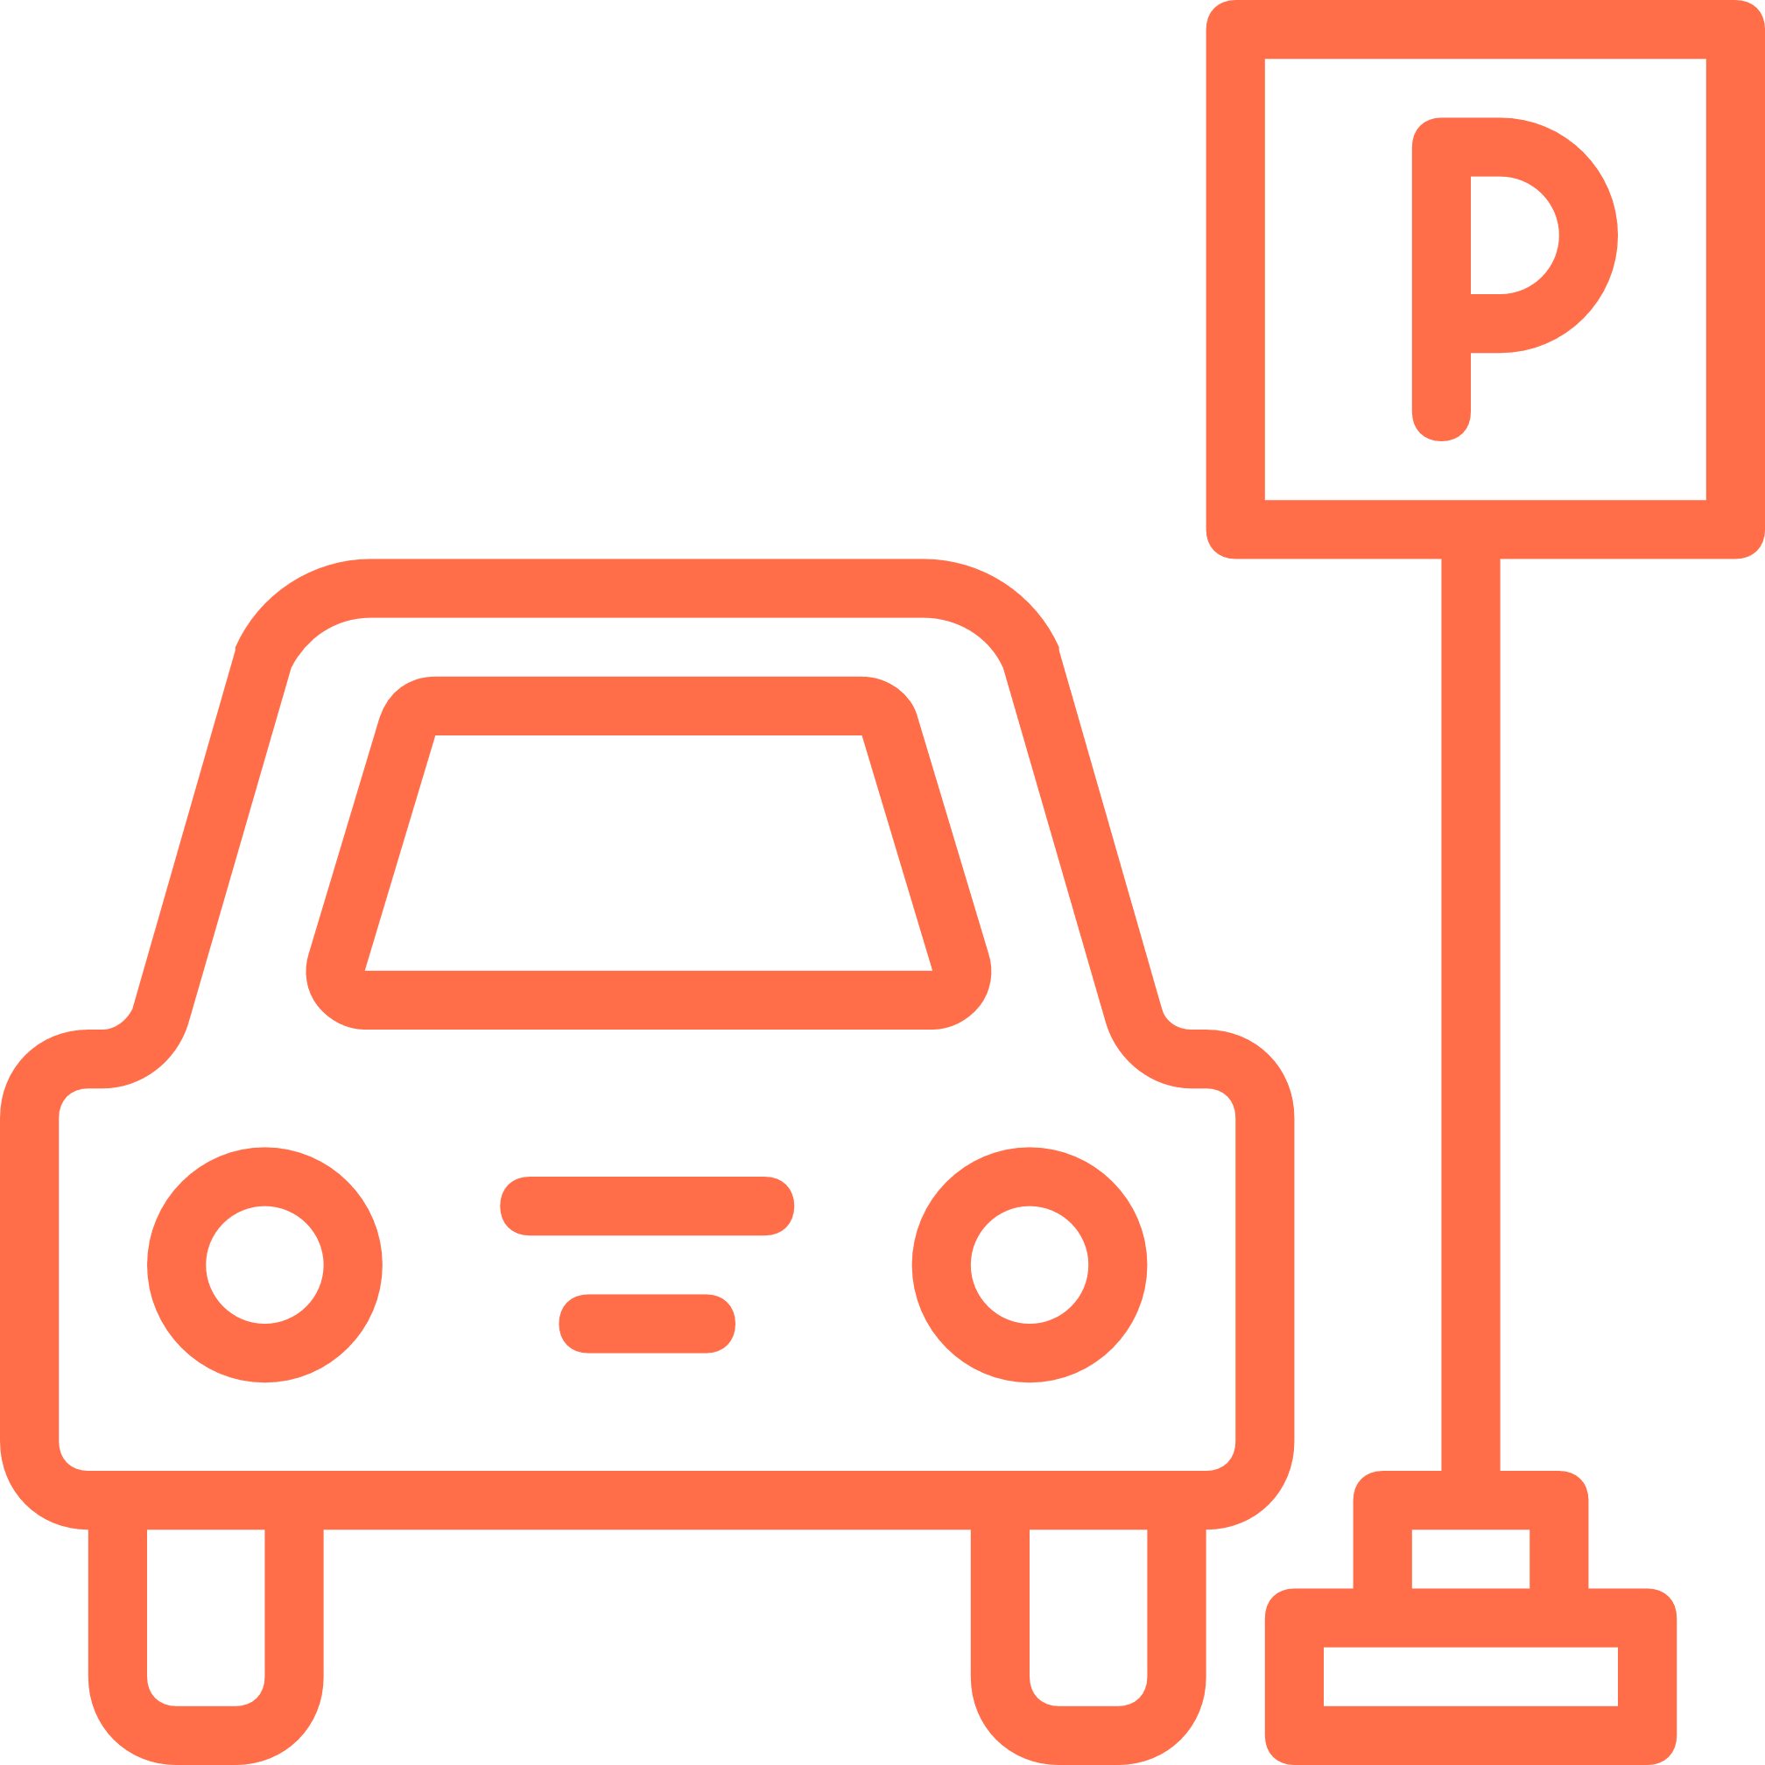

COMMUNICATION
SPACE
EMISSIONS AND ENERGY EFFICIENCY
PROBLEMS OF URBAN TRANSPORTATION
LABOR AND SAFETY
Notes:
COMMUNICATION:
Our application provides an easy to use platform for a user to get matched with people with similar commuting routes
EMISSIONS AND ENERGY EFFICIENCY:
By reducing the number of vehicles that constitute traffic, greenhouse gas emissions can drastically reduce
LABOR AND SAFETY:
Our application can reduce the costs of transportation while providing a stable solution with a safe way to pay for it
SPACE:
By having less vehicles going to schools and workplaces, there will be more space for the ones that do

Slide 5











Value Proposition
Echo friendly
Share ride expenses
Connect to people
Meeting new people
Simple interface
Safe/ Convenient
Reliable Schedule
Secure payment
Affordable
Products & Services
FIT
Gain Creators
Gains
Jobs
Pains
Daily commute to school/workplace
Pain Relievers
Travel with (like minded) people
Expensive and unreliable
Traveling alone
Wants to travel but doesn’t want to drive
Fixed and fair pricing
Place to park
Traffic

Slide 6









Business Model Canvas
Key Partnerships
Key Activities
Value Proposition
Costumer Relationship
Costumer Segments
- City Council
- Investors
Other Partners:
- Payment Processors
- Gps/Maps
- Analytics
- Product development and management
- Building drivers and passenger network
- Analysing data and optimizing
- Lower Cost
- Environmentally friendly
- Sociable trips
- Secure Online Payment
- Rating and Matching system
- Self & Automated service
- Customer Service: chatbot, email support
Drivers:
- People who own a car
- People who want to meet new people
- People interested in commuting at lower costs
Passengers:
- People who want to share a ride frequently
- People who want to travel comfortably at lower prices
Key Resources
Channels
- Technological Platform
- Skilled staff
- Mobile App
- Social Media channels
- Apps/App store
Cost Structure
Revenue Streams
- Technological set up and running cost
- Employees
- Marketing and Customer Acquisition
- Commissions on trips
- Sponsorships

Slide 7
Questions?

